Slide 1

ORCHESTRA: Rapid, Collaborative
Sharing of Dynamic Data
Zachary Ives, Nitin Khandelwal,
Aneesh Kapur, University of Pennsylvania
Murat Cakir, Drexel University
2nd Conference on Innovative Database Systems Research
January 5, 2005

Slide 2
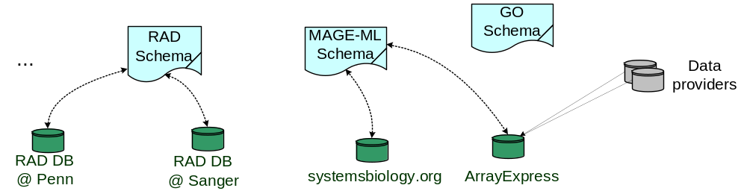
Data Exchange among Bioinformatics Warehouses & Biologists
Different bioinformatics institutes, research groups store their data in separate warehouses with related, “overlapping” data
  Each source is independently updated, curated locally
  Updates are published periodically in some “standard” schema
    Each site wants to import these changes, maintain a copy of all data
    Individual scientists also import the data and changes, and would like to share their derived results
  Caveat: not all sites agree on the facts!
  Often, no consensus on the “right” answer!

Slide 3
A Clear Need for a General Infrastructure for Data Exchange
Bioinformatics exchange is done with ad hoc, custom tools – or manually – or not at all!
  (NOT an instance of file sync, e.g., Intellisync, Harmony; or groupware)
It’s only one instance of managing the exchange of independently modified data, e.g.:
  Sharing subsets of contact lists (colleagues with different apps)
  Integrating and merging multiple authors’ bibTeX, EndNote files
  Distributed maintenance of sites like DBLP, SIGMOD Anthology
This problem has many similarities to traditional DBs/data integration:
  Structured or semi-structured data
  Schema heterogeneity, different data formats, autonomous sources
  Concurrent updates
  Transactional semantics

Slide 4
Challenges in Developing Collaborative Data Sharing “Middleware”
How do we coordinate updates between conflicting collaborators?
How do we support rapid & transient participation, as in the Web or P2P systems?
How do we handle the issues of exchanging updates across different schemas?
These issues are the focus of our work on the ORCHESTRA Collaborative Data Sharing System

Slide 5
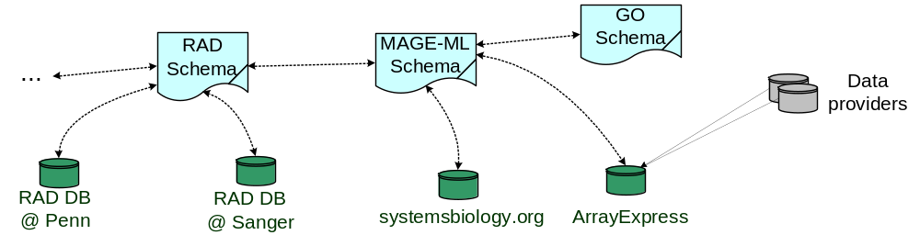
Our Data Sharing Model
Participants create & independently update local replicas of an instance of a particular schema
  Typically stored in a conventional DBMS
Periodically reconcile changes with those of other participants
  Updates are accepted based on trust/authority – coordinated disagreement
Changes may need to be translated across mappings between schemas
  Sometimes only part of the information is mapped

Slide 6
The ORCHESTRA Approach to the Challenges of Collaborative Data Sharing
Coordinating updates between disagreeing collaborators
  Allow conflicts, but let each participant specify what data it trusts (based on origin or authority)
Supporting rapid & transient participation
Exchange updates across different schemas

Slide 7
The Origins of Disagreements (Conflicts)
Each source is individually consistent, but may disagree with others
Conflicts are the results of mutually incompatible updates applied concurrently to different instances, e.g.,:
  Participants A and B have replicas containing different tuples with the same key
  An item is removed from Participant A but modified in B
  A transaction results in a series of values in Participant B, one of which conflicts with a tuple in A

Slide 8
Multi-Viewpoint Tables (MVTs)
Allow unification of conflicting data instances:
  Within each relation, allow participants p,p’ their own viewpoints that may be inconsistent
  Add two special attributes:
    Origin set:
    Set of participants whose data contributed to the tuple
    Viewpoint set:
    Set of participants who accept the tuple (for trust delegation)
    Simple form of data provenance [Buneman+ 01] [Cui & Widom 01] and similar in spirit to Info Source Tracking [Sadri 94]
After reconciliation, participant p receives a consistent subset of the tuples in the MVT that:
  Originate in viewpoint p
  Or originate in some viewpoint that participant p trusts

Slide 9
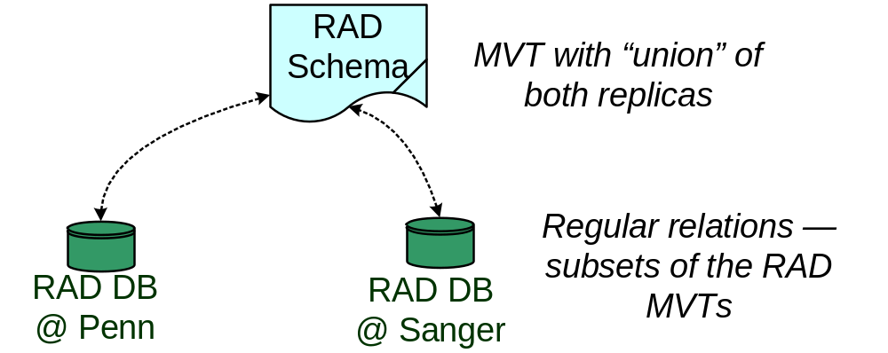
MVTs allow Coordinated Disagreement
Each shared schema has a MVT instance
Each individual replica holds a subset of the MVT
An instance mapping filters from the MVT, based on viewpoint and/or origin sets
  Only non-conflicting data gets mapped

Slide 10
An Example MVT with 2 Replicas
(Looking Purely at Data Instances)
RAD:Study
t | origin | viewpoint
a | Penn | Penn
RAD:Study@Penn(t) = RAD:Study(t), contains(origin(t), ArrayExp)
RAD:Study@Sanger(t) = RAD:Study(t), contains(viewpoint(t), Penn)
t
a
t
a

Slide 11
An Example MVT with 2 Replicas
(Looking Purely at Data Instances)
RAD:Study
t | origin | viewpoint
a | Penn | Penn
b | ArrayExp | ArrayExp
c | systemsbio | systemsbio
}
Insertions
from elsewhere
RAD:Study@Penn(t) = RAD:Study(t), contains(origin(t), ArrayExp)
RAD:Study@Sanger(t) = RAD:Study(t), contains(viewpoint(t), Penn)
t
a
t
a

Slide 12
An Example MVT with 2 Replicas
(Looking Purely at Data Instances)
RAD:Study
t | origin | viewpoint
a | Penn | Penn
b | ArrayExp | ArrayExp
c | systemsbio | systemsbio
RAD:Study@Penn(t) = RAD:Study(t), contains(origin(t), ArrayExp)
RAD:Study@Sanger(t) = RAD:Study(t), contains(viewpoint(t), Penn)
t
a
b
t
a
Reconciling participant

Slide 13
An Example MVT with 2 Replicas
(Looking Purely at Data Instances)
RAD:Study
t | origin | viewpoint
a | Penn | Penn
b | ArrayExp | ArrayExp,Penn
c | systemsbio | systemsbio
Accepted
into viewpoint
RAD:Study@Penn(t) = RAD:Study(t), contains(origin(t), ArrayExp)
RAD:Study@Sanger(t) = RAD:Study(t), contains(viewpoint(t), Penn)
t
a
b
t
a

Slide 14
An Example MVT with 2 Replicas
(Looking Purely at Data Instances)
RAD:Study
t | origin | viewpoint
a | Penn | Penn
b | ArrayExp | ArrayExp,Penn
c | systemsbio | systemsbio
RAD:Study@Penn(t) = RAD:Study(t), contains(origin(t), ArrayExp)
RAD:Study@Sanger(t) = RAD:Study(t), contains(viewpoint(t), Penn)
t
a
b
t
a
b
Reconciling participant

Slide 15
An Example MVT with 2 Replicas
(Looking Purely at Data Instances)
RAD:Study
t | origin | viewpoint
a | Penn | Penn
b | ArrayExp | ArrayExp,Penn,Sanger
c | systemsbio | systemsbio
RAD:Study@Penn(t) = RAD:Study(t), contains(origin(t), ArrayExp)
RAD:Study@Sanger(t) = RAD:Study(t), contains(viewpoint(t), Penn)
t
a
b
t
a
b

Slide 16
The ORCHESTRA Approach to the Challenges of Collaborative Data Sharing
Coordinating updates between disagreeing collaborators
Supporting rapid & transient participation
  Ensure data or updates, once published, are always available regardless of who’s connected
Exchanging updates across different schemas

Slide 17
Participation in ORCHESTRA is Peer-to-Peer in Nature
Study₁
Study₂
Global RAD MVTs
P₁
P₂
RAD:Study MVT
local RAD instance
local RAD instance
Server and client roles for every participant p:
  Maintain a local replica of the database interest at p
  Maintain a subset of every global MVT relation; perform part of every reconciliation
    Partition the global state and computation across all available participants
    Ensures reliability and availability, even with intermittent participation
Use peer-to-peer distributed hash tables (Pastry [Rowstron & Druschel 01])
  Relations partitioned by tuple, using <schema, relation, key attribs>
  DHT dynamically reallocates MVT data as nodes join and leave
  Replicates the data so it’s available if nodes disappear

Slide 18
Reconciliation of Deltas
Publish, compare, and apply delta sequences
  Find the set of non-conflicting updates
  Apply them to a local replica to make it consistent with the instance mappings
    Similar to what’s done in incremental view maintenance [Blakeley 86]
Our notation for updates to relation r with tuple t:
  insert: +r(t)
  delete: -r(t)
  replace: →r(t / t’)

Slide 19
Semantics of Reconciliation
Each peer p publishes its updates periodically
  Reconciliation compares these with all updates published from elsewhere, since the last time p reconciled
What should happen with update “chains”?
  Suppose p changes the tuple A → B → C and another system does D → B → E
  In many models this conflicts – but we assert that intermediate steps shouldn’t be visible to one another
  Hence we remove intermediate steps from consideration
    We compute and compare the unordered sets of tuples removed from, modified within, and inserted into relations

Slide 20
Distributed Reconciliation in Orchestra
Initialization:
  Take every shared MVT relation, compute its contents, partition its data across the DHT
Reconciliation @ participant p:
  Publish all p’s updates to the DHT, based on the key of the data being affected; attach to each update its transaction ID
  Each peer is given the complete set of updates applied to a key – it can compare to find conflicts at the level of the key, and of the transaction
  Updates are applied if there are no conflicts in a transaction
(More details in paper)

Slide 21
The ORCHESTRA Approach to the Challenges of Collaborative Data Sharing
Coordinating updates between disagreeing collaborators
Supporting rapid & transient participation
Exchanging updates across different schemas
  Leverage view maintenance and schema mediation techniques to maintain mapping constraints between schemas

Slide 22
Reconciling Between Schemas
We define update translation mappings in the form of views
  Automatically (see paper) derived from data integration and peer data management-style schema mappings
    Both forward and “inverse” mapping rules, analogous to forward and inverse rules
  Define how to compute a set of deltas over a target relation that maintain the schema mapping, given deltas over the source
    Disambiguates among multiple ways of performing the inverse mapping
  Also user-overridable for custom behavior (see paper)

Slide 23
The Basic Approach
(Many more details in paper)
For each relation r(t), and each type of operation,
define a delta relation containing the set of operations of the specified type to apply:
  deletion: -r(t)
  insertion: +r(t)
  replacement: →r(t / t’)
Create forward and inverse mapping rules in Datalog (similar to mapping & inverse rules in data integration) between these delta relations
  Based on view update [Dayal & Bernstein 82]
  [Keller 85]/maintenance [Blakeley 86] algorithms, derive queries over deltas to compute updates in one schema from updates (and values) in the other
  A schema mapping between delta relations (sometimes joining with standard relations)

Slide 24
Example Update Mappings
Schema mapping: r(a,b,c) :- s(a,b), t(b,c)
Deletion mapping rules for Schema 1, relation r (forward):
-r(a,b,c) :- -s(a,b), t(b,c)
-r(a,b,c) :- s(a,b), -t(b,c)
-r(a,b,c) :- -s(a,b), -t(b,c)
Deletion mapping for Schema 2, relation t (inverse):
-t(a,c) :- -r(a,_,c)

Slide 25
Using Translation Mappings to Propagate Updates across Schemas
We leverage algorithms from Piazza [Tatarinov+ 03]
  There: answer query in one schema, given data in mapped sources
  Here: compute the set of updates to MVTs that need to be applied to a given schema, given mappings + changes over other schemas
Peer p reconciles as follows:
  For each relation r in p’s schema, compute the contents of –r, +r, →r
  “Filter” the delta MVT relations according to the instance mapping rules
  Apply the deletions in -r, replacements in →r, and insertions in +r

Slide 26
Translating the Updates across Schemas – with Transitivity
Δ
SML
MADAM
TIGR
Δ’
Δ
Δ’’
Δ
RAD
MAGE-ML
Δ’
GO

Slide 27
Implementation Status and Early Experimental Results
The architecture and basic model – as seen in this paper – are mostly set
Have built several components that need to be integrated:
  Distributed P2P conflict detection substrate (single schema):
    Provides atomic reconciliation operation
  Update mapping “wizard”:
    Preliminary support for converting “conjunctive XQuery” as well as relational mappings to update mappings
    Experiments with bioinformatics mappings (see paper):
      Generally a limited number of candidate inverse mappings (~1-3) for each relation – easy to choose one
      Number of “forward” rules is exponential in # joins
  Main focus: “tweaking” the query reformulation algorithms of Piazza
    Each reconciliation performs the same “queries” – can cache work
    May be able to do multi-query optimization of related queries

Slide 28
Conclusions and Future Work
ORCHESTRA focuses on trying to coordinate disagreement, rather than enforcing agreement
  Significantly different from prior data sharing and synchronization efforts
  Allows full autonomy of participants – offers scalability, flexibility
Central ideas:
  A new data model that supports “coordinated disagreement”
  Global reconciliation and support for transient membership via P2P distributed hash substrate
  Update translation using extensions to peer data management and view update/maintence
Currently working on integrated system, performance optimization

